Slide 1

Uncovering Global Action Hotspots: Data-Driven Strategies for Netflix Content Acquisition
SUBTITLE HERE

Slide 2
introduction
In today's fiercely competitive streaming market, retaining subscribers and attracting new ones hinges on offering content that resonates with their preferences. For Netflix, a key challenge lies in selecting the right content to acquire – balancing established audience favorites with potentially high-demand yet unproven genres. The landscape of streaming services is constantly evolving, with new platforms emerging and viewer preferences continuously shifting. To stay ahead of the curve, Netflix, a major player in the industry, needs to adopt a data-driven approach to content acquisition. This presentation will delve into how Netflix can utilize a dataset called "netflix_titles" to gain valuable insights and optimize its content acquisition strategy. By analyzing this data, Netflix can make informed decisions about acquiring content that aligns with subscriber preferences and has the potential to attract new viewers.
Optimizing Content Acquisition for Netflix

Slide 3
Business Case: Optimizing Content Acquisition for Netflix using Demand Forecasting
Netflix has a vast library of content, but acquiring new shows and movies can be expensive. To maximize return on investment, Netflix needs to prioritize content that aligns with subscriber preferences and has high potential viewership. This business case proposes a data-driven approach using clustering algorithms and demand forecasting to optimize Netflix's content acquisition strategy
Benefits:
Data-Driven Decisions: Move beyond intuition and rely on data analysis to identify promising content.
Improved ROI: Allocate resources towards content with a higher likelihood of attracting and retaining subscribers.
Content Diversification: Balance between established genres and potentially high-demand but new categories to cater to a wider audience.
Trend Identification: Proactively identify and capitalize on emerging genres or content themes.
Implementation:
Develop a machine learning pipeline to automate data processing, clustering, and demand forecasting.
Integrate the model with Netflix's content acquisition workflow to prioritize content recommendations.
Continuously monitor and refine the model as new data becomes available and user preferences evolve.

Slide 4
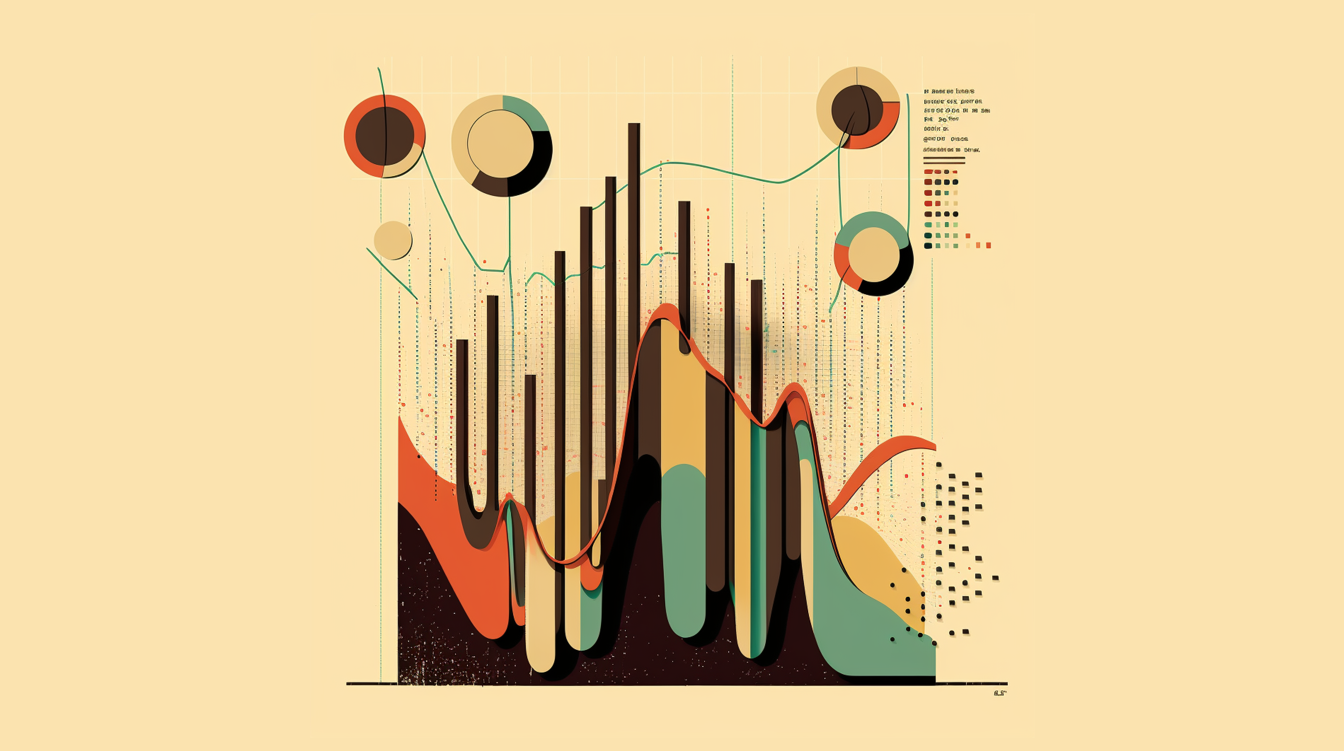

Demand Forecasting
In today's dynamic market, accurately predicting customer demand is essential for business success.
Explanation: Demand forecasting uses historical data and analytical techniques to anticipate future customer needs. This allows businesses to:
Optimize Inventory Levels: Maintain the right amount of stock to avoid stockouts or overstocking.
Refine Production Plans: Adjust production schedules to meet forecasted demand.
Develop Targeted Marketing Strategies: Focus marketing efforts on products with high predicted demand.
Benefits: By effectively forecasting demand, businesses can:
Enhance Customer Satisfaction: Deliver the products customers need, when they need them.
Improve Profitability: Reduce waste and optimize resource allocation.
Gain a Competitive Advantage: Proactively respond to market changes and customer trends.
Demand forecasting is a powerful tool for any business looking to stay ahead of the curve and thrive in the ever-changing marketplace.

Slide 5
Clustering Algorithms
Clustering algorithms belong to the realm of unsupervised machine learning, meaning they don't require pre-labeled data. They work by analysing the inherent characteristics within the data itself and group similar data points together. This process helps us identify hidden patterns, structures, and relationships within the data that might not be readily apparent through traditional analysis methods.
Unsupervised Learning: No pre-labeled data required.
Grouping Similar Data: Clusters contain data points with similar characteristics.
Pattern Discovery: Uncovers hidden patterns, structures, and relationships within data.
Unveiling Hidden Patterns in Data

Slide 6

Data and Methodology
Data Acquisition: Utilize the provided "netflix_titles" dataset containing information like genre, release year, and type (movie/TV show). Ideally, integrate viewership data (hours watched, completion rates) directly from Netflix for a more accurate picture.
Data Preprocessing: Clean and standardize the data (e.g., convert categorical variables).
Content Acquisition Strategy:
Prioritize content acquisition for genres or categories within clusters that show high potential demand based on forecasts.
Consider balancing risk by acquiring a mix of established genres (e.g., popular sitcoms) and potentially high-demand but unproven genres (e.g., innovative documentary styles).

Slide 7

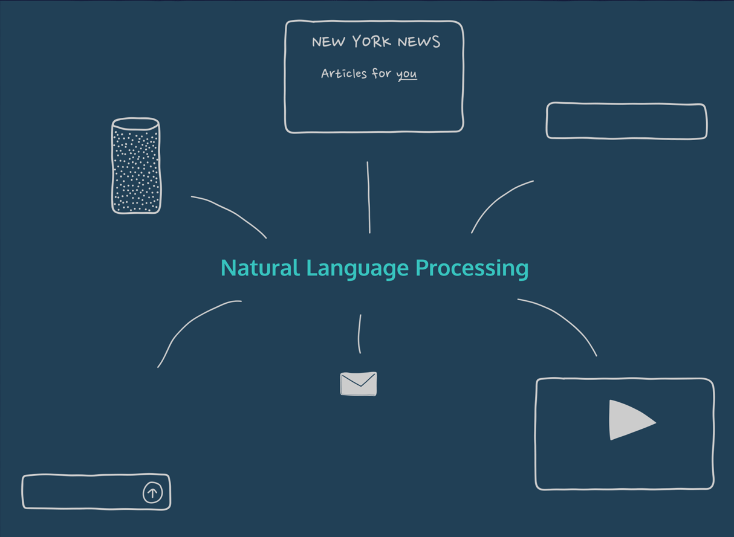
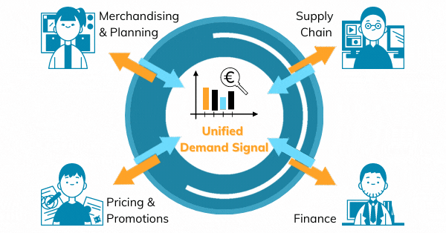
Algorithms used
Kmean
Clean Dataset
NLP
Cluster forming
Demand forecasting
Visualization

Slide 8

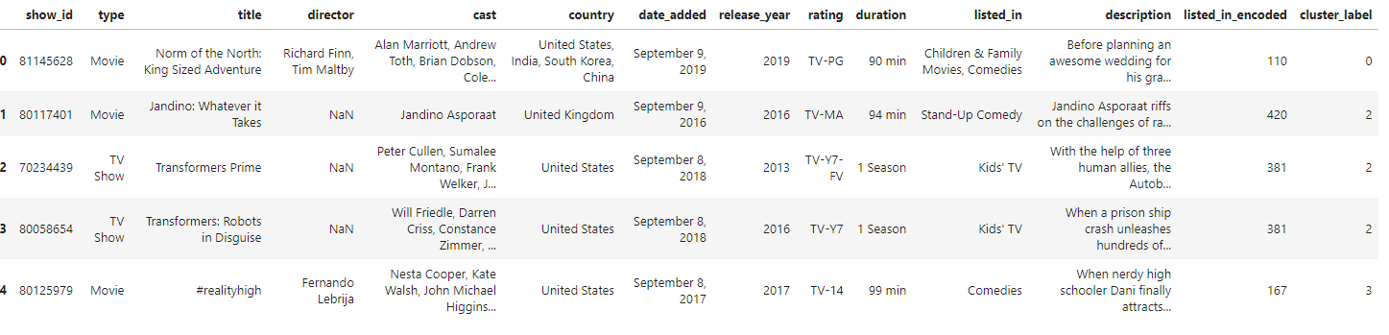
Data Set And optimized cluster
Cluster 4:
Top Genres: Action & Adventure, Dramas, International Movies 103
Action & Adventure, International Movies 75
Action & Adventure 68
Action & Adventure, Comedies, International Movies 57
Action & Adventure, Sci-Fi & Fantasy 49
Name: listed_in, dtype: int64
Prioritize acquiring content considering top genres and external demand indicators.

Slide 9
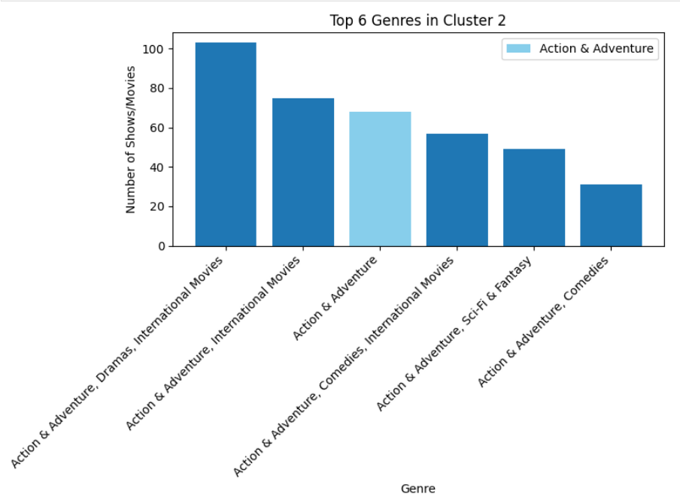
Genre Distribution Bar Chart
This chart will visually represent the dominance of Action & Adventure within Cluster 2.
X-axis: List all genres present in the "listed_in" data for Cluster 2.
Y-axis: Number of shows/movies belonging to each genre (use the counts from the provided data).
Highlight: Emphasize the bar for "Action & Adventure" to show its dominance.

Slide 10
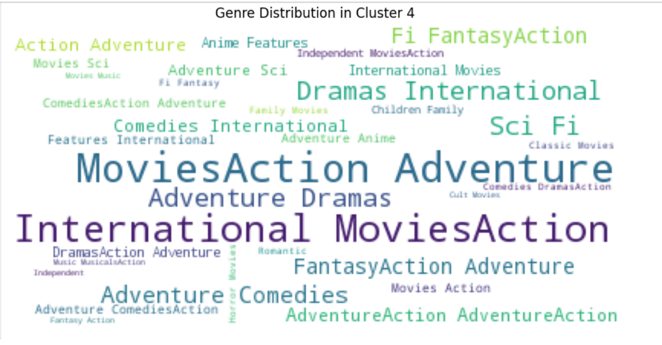
Dominant Genres in Cluster 4
This word cloud represents the distribution of genres within Cluster 2. The size of each word corresponds to the frequency of that genre. Genres like Action & Adventure (highlighted in red) are more prominent, while others appear less frequently
"The dominance of Action & Adventure suggests a preference for fast-paced and exciting content within this cluster."

Slide 11
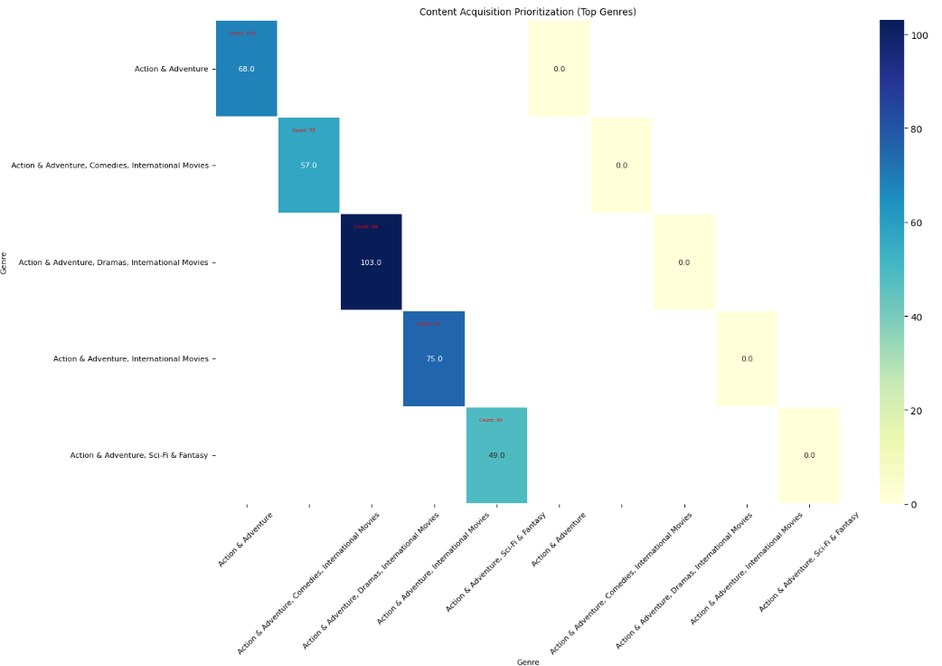
Top Genres with Heatmap
Heatmap Interpretation:
Heatmap intensity represents the number of action movies originating from each country. Darker areas indicate a higher concentration of action movies.
Purpose:
Identify potential target markets for international action content acquisition by highlighting prominent regions in the heatmap.

Slide 12

Conclusion
By leveraging clustering algorithms, demand forecasting, and a data-driven approach, Netflix can optimize its content acquisition strategy. This can lead to a more engaged subscriber base, increased viewership, and a stronger competitive advantage in the streaming market.

